Slide 1
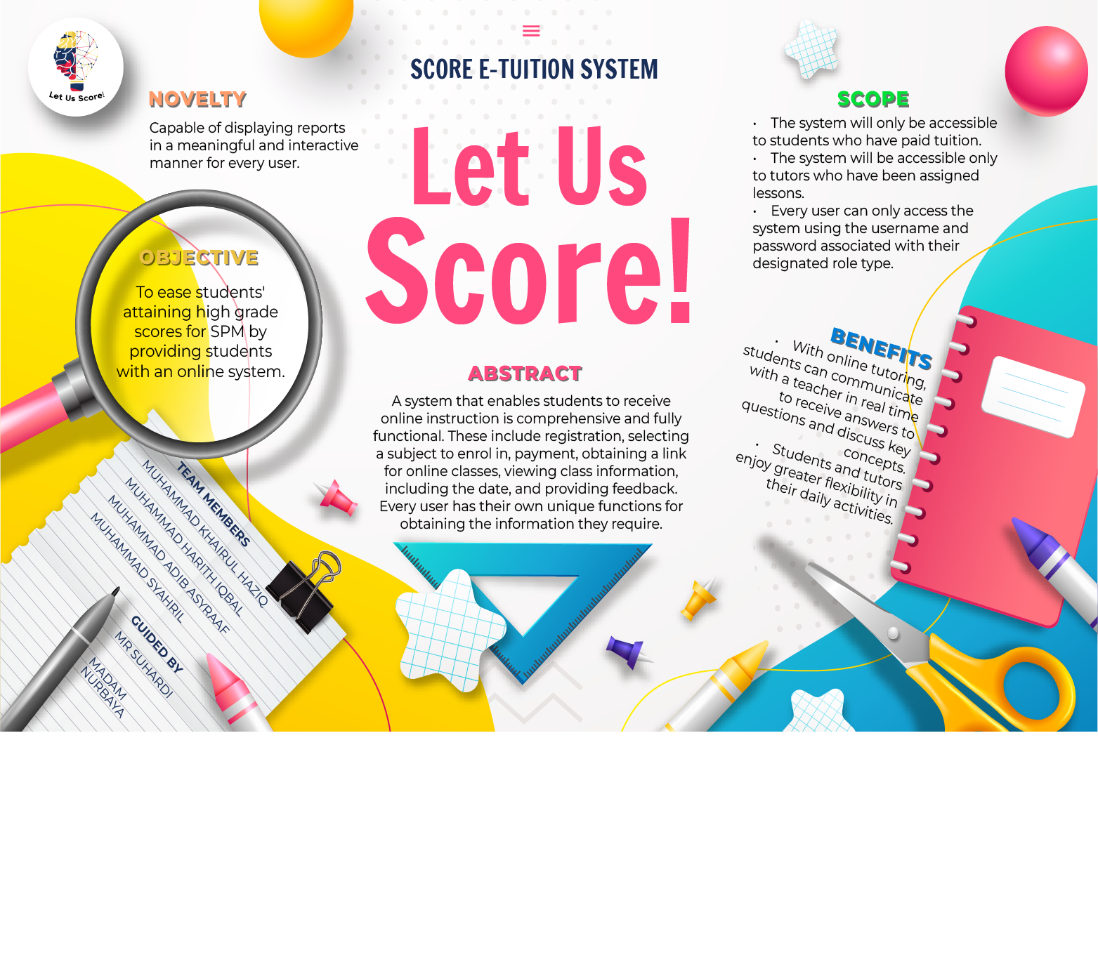

Slide 2

Let Us Score!
(Score E-Tuition System)
2

Slide 3
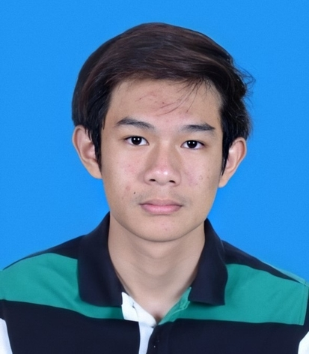
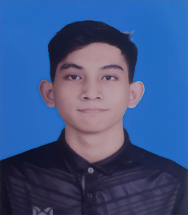
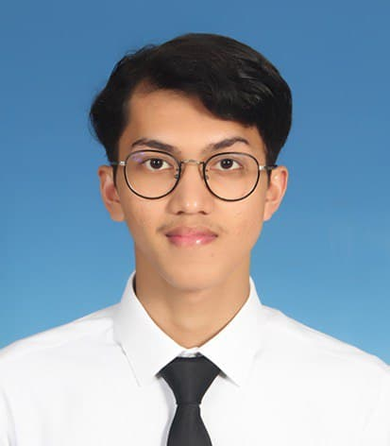

OUR CREW MEMBER
ADIB ASYRAAF
Chief Executive Officer
2020868324
KHAIRUL HAZIQ
Full Stack Developer
2020475884
HARITH IQBAL
Mobile Application Developer
2020450636
SYAHRIL RUMIZAM
Database Designer
2020843956
3

Slide 4

OBJECTIVE
To ease students' attaining high grade scores for SPM by providing students with an online system.
4

Slide 5
Let
ABSTRACT
Us
A system that enables students to receive online instruction is comprehensive and fully functional. These include registration, selecting a subject to enroll in, payment, obtaining a link for online classes, viewing class information, including the day, and providing feedback. Every user has their own unique functions for obtaining the information they require.
Score
5

Slide 6
SCOPE
The system will only be accessible to students who have paid tuition.
The system will be accessible only to tutors who have been assigned lessons.
Every user can only access the system using the username and password associated with their designated role type.
6

Slide 7

NOVELTY
Capable of displaying reports in a meaningful and interactive manner for every user.
7

Slide 8

BENEFITS
With online tutoring, students can communicate with a teacher in real time to receive answers to questions and discuss key concepts.
Students and tutors enjoy greater flexibility in their daily activities.
LET US SCORE
MATH
PHYSICS
CHEMISTRY
8

Slide 9
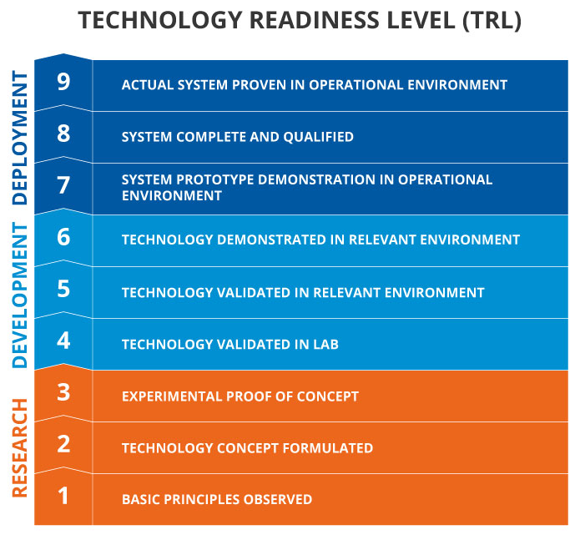
Web-based Information System
Software used to develop:
XAMPP
Visual Studio Code
Software needed to use the system:
XAMPP
Any internet browser
Mobile Applications
Software used to develop:
MIT App Inventor
XAMPP
Visual Studio Code
Software needed to use the system:
MIT App Inventor
BlueStack or any emulator
9

Slide 10
DATA FLOW DIAGRAM (DFD)
10

Slide 11
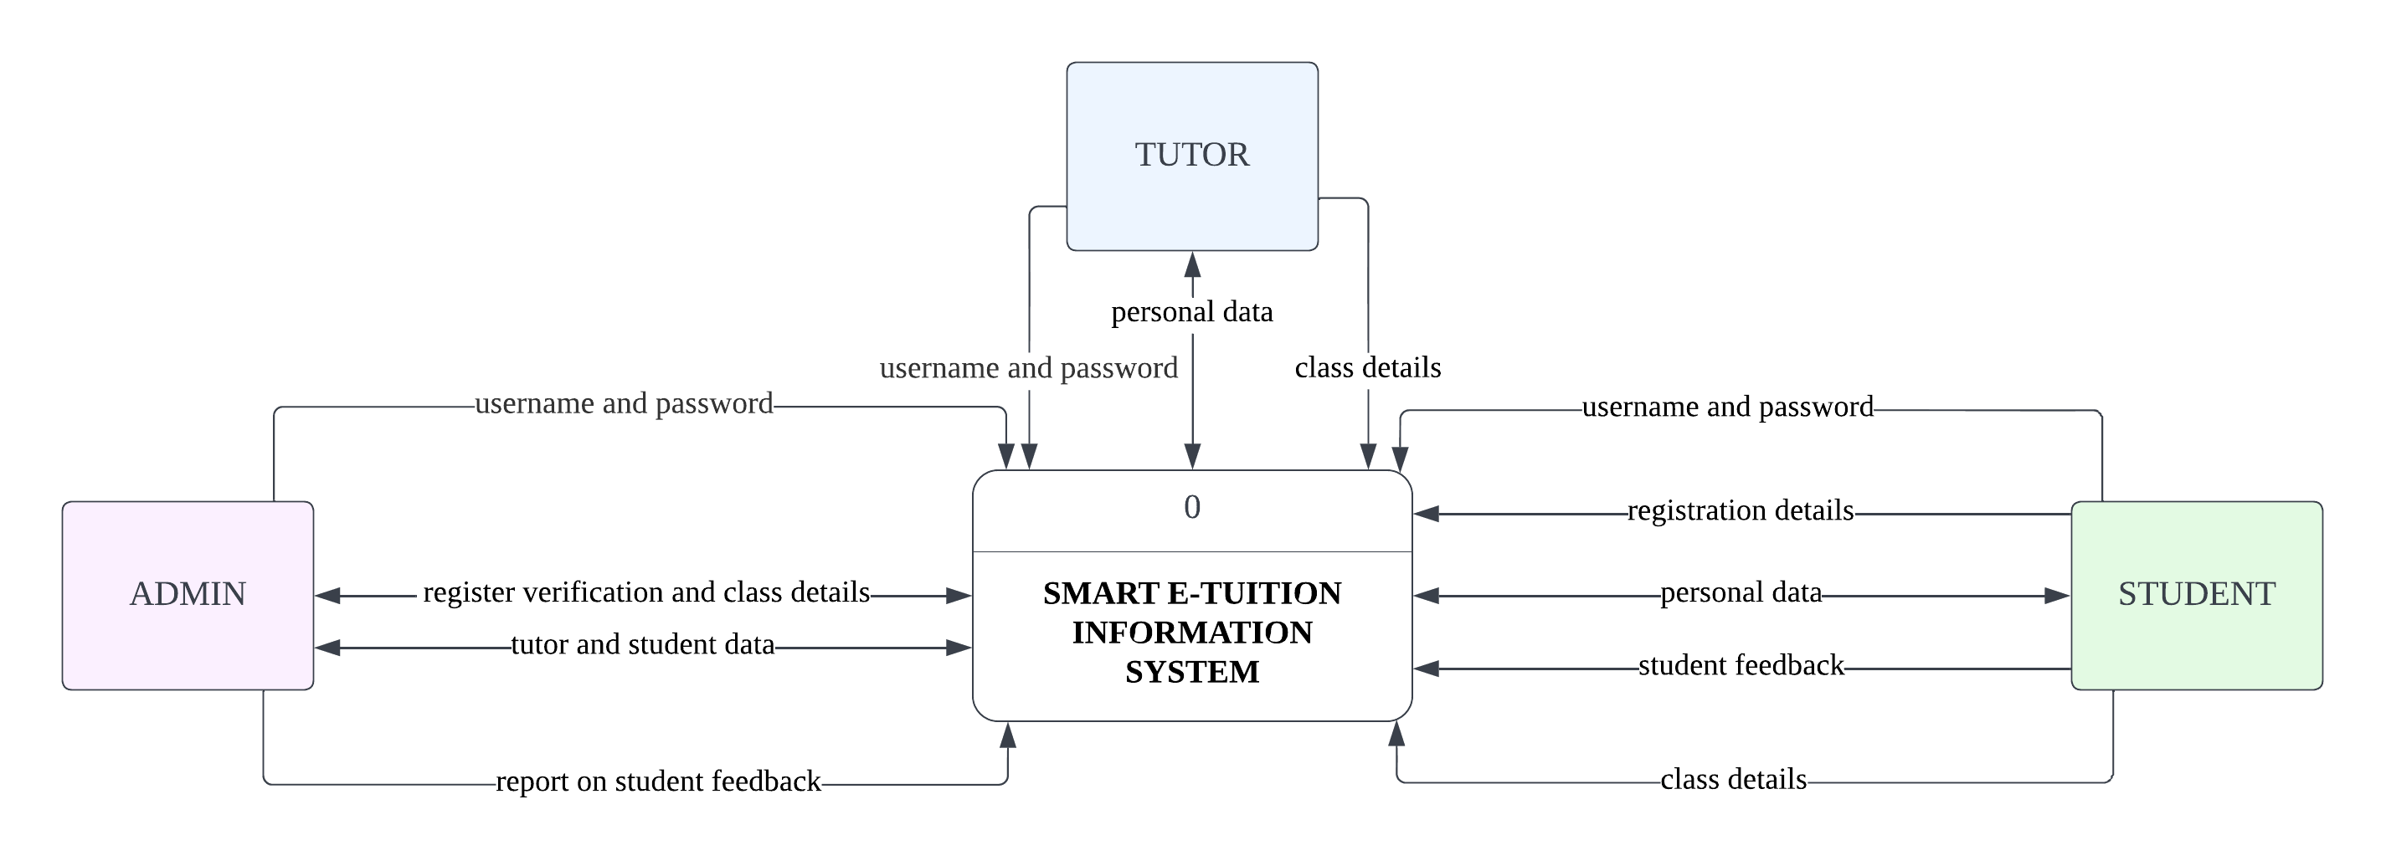
CONTEXT DIAGRAM
11

Slide 12
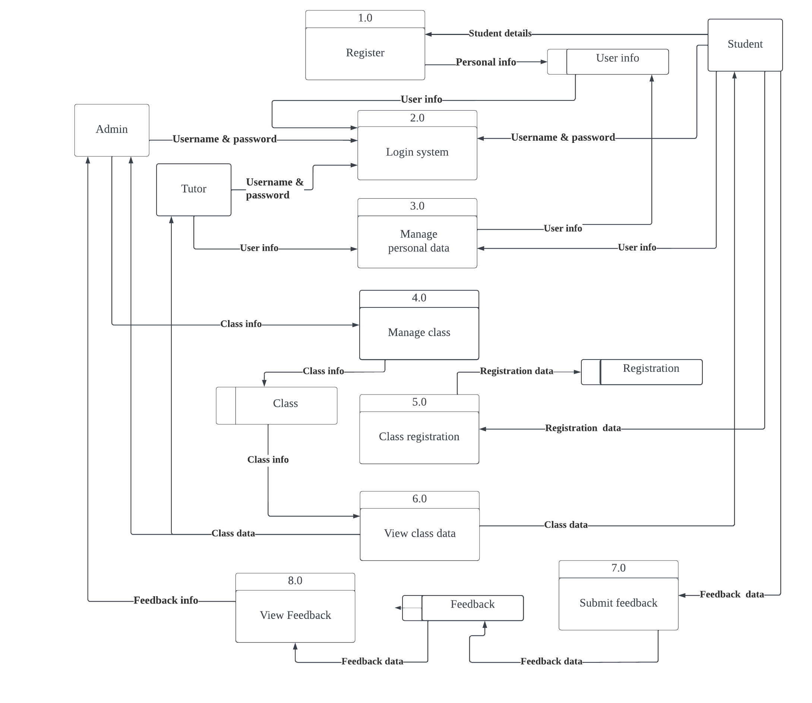
LEVEL 0 DIAGRAM
12

Slide 13
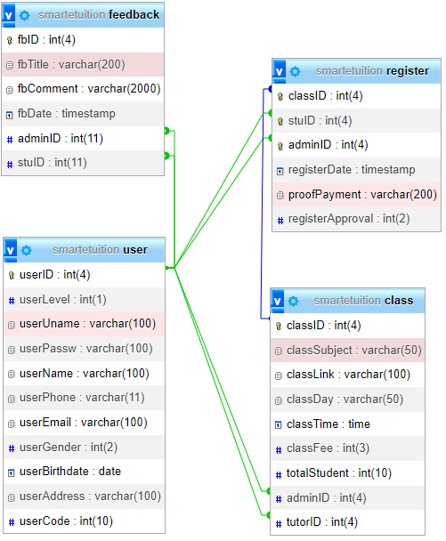
ENTITY RELATIONSHIP DIAGRAM
(ERD)
13

Slide 14
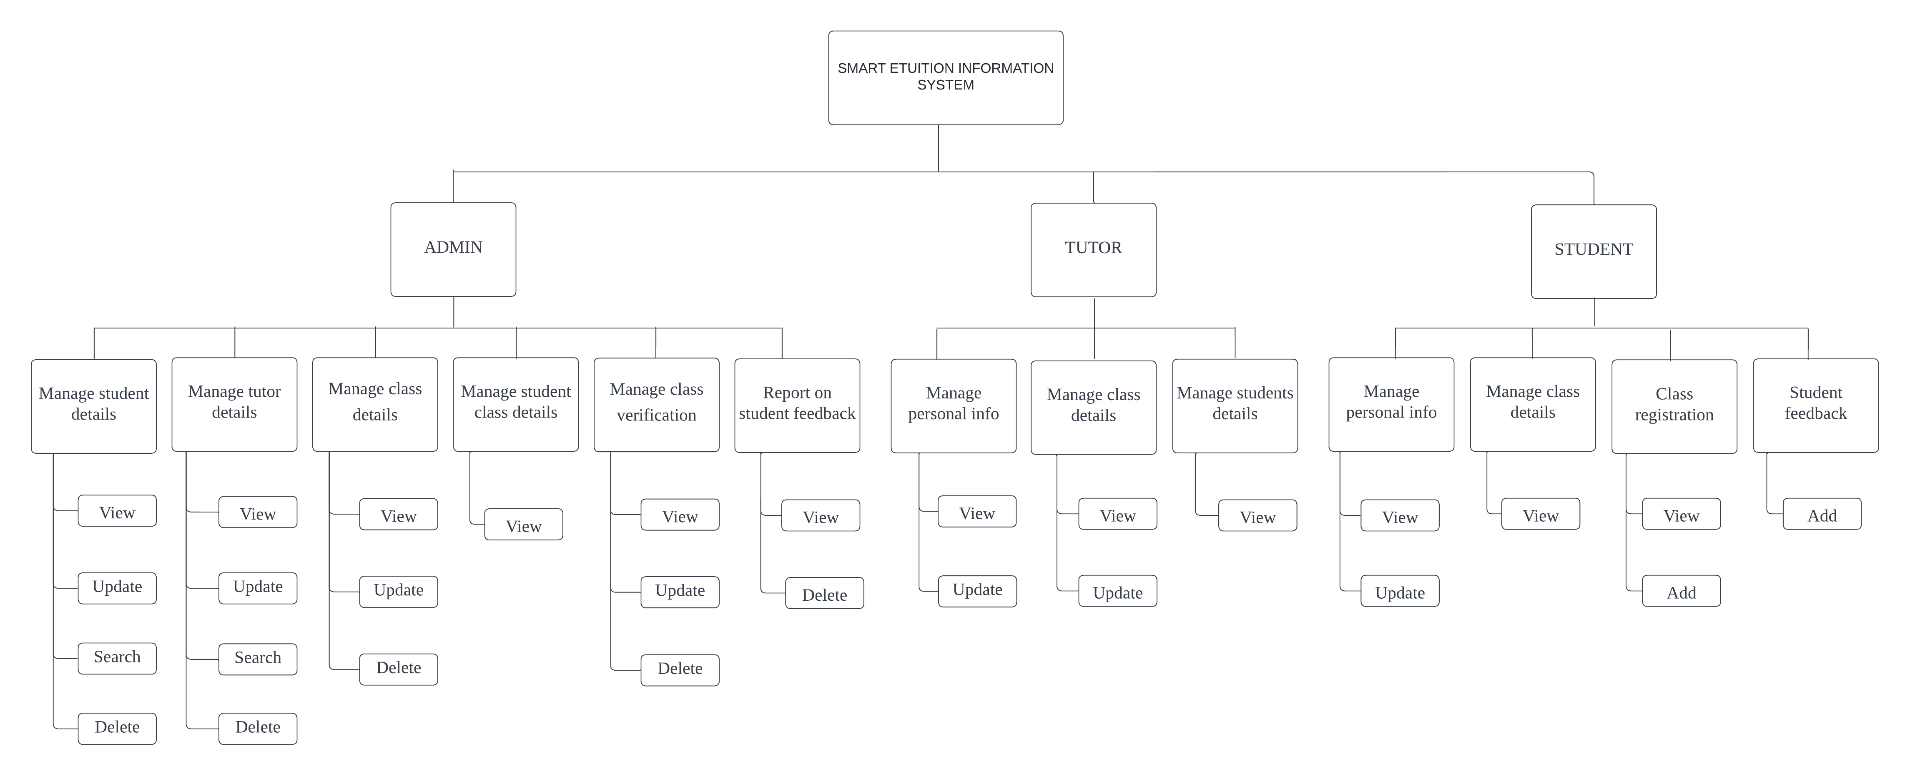
FUNCTIONAL DECOMPOSITION DIAGRAM
14

Slide 15
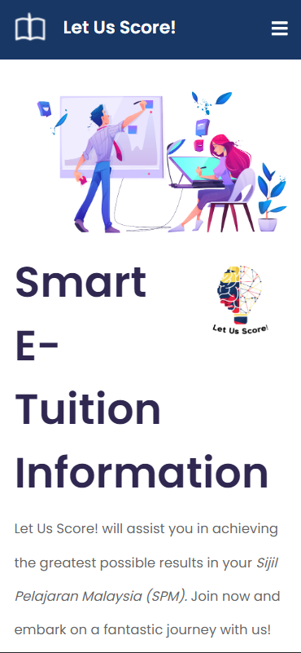
ABOUT US
Let Us Score Sdn. Bhd. was incorporated in 2014. Operating ten outlets of tuition center all over Kedah with students numbering four thousand annually. The pandemic struck during 2020.
We are one of the few brands that managed to convert to online for about 100 students. The practicality, the efficiency of online is undefeated when compared to offline operation. Now, Score E-Tuition System is the future.
15

Slide 16
MISSION
To organize the students information and make it useful in its own way.
VISION
To make sure education in Malaysia keep striving forward globally.

Slide 17

PRODUCT TO SELL
Web-based information systems and mobile applications. Both include every functions needed from the student, tutor, and admin dashboard where each role has their own specific responsibilities.
17

Slide 18
18

Slide 19






Score E-Tuition System
CONTACT US
OUR ADDRESS
UiTM Cawangan Kedah 08400 Kuala Muda, Kedah, Malaysia
OUR NUMBER
+603-5637-3337
+603-4023-9252
OUR EMAIL
smartetuition@gmail.com
19

